Slide 1
Graphical Processing Units For Deep Learning
The key that gave rise to the era of Artificial Intelligence.
Saransh Agrawal
-170921060

Slide 2
Machine Learning
Conventional Programming
Machine Learning Approach
Rules
Conventional Programming
Answers
Data
Data
Machine Learning
Rules
Answers

Slide 3
Steps in Machine Learning
Collection and Division of Dataset
Exploratory Data Analysis
Pre-Processing of Dataset
Model formation and Training
Model Evaluation

Slide 4
Training a Model
Forward Propagation
Calculate Cost
Backward Propagation
Update Parameters
Actual Output (y)
Model (Parameters W_{n} , b)
Data Features (x_{n})
Forward Propagation
Output (ŷ)
Loss Function (l)
Backward Propagation
Update (hyperparameter (α) )
Fig 1: Block diagram of training a model

Slide 5




Logistic Regression
Random Initialization
Loss (Cross Entropy)
$l(a,y)$ = -(y log(a) +(1-y)log(1-a))
W [n_{x} , 1]
Activation (Sigmoid)
Linear function
Cost Function
a = σ(Z) = $\frac{1}{1+e^{−z}}$
X [n_{x} , m]
Z = W^{T}X + b
Z [1,m]
Ŷ [1,m]
$$J\left(w,b\right)= \frac{1}{m}\sum_{i=1}^{m}{l(a,y)}$$
Update
Gradient Descent
W = W- α.dW; b = b- α.db
dZ = A-Y; dW = $\frac{1}{m} dZT$ ; db = $\frac{1}{m} dZT$
Fig 2: Block diagram including equations for training a ML model

Slide 6
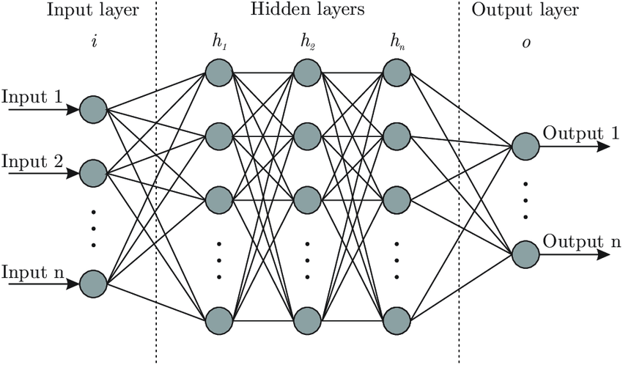
Deep Neural Network
[3,2][2,1] = [3,1]
[3,3][3,1] = [3,1]
W [number of neurons in current layer, number of neurons in previous layer]
[3,3][3,1] = [3,1]
[1,3][3,1] = [1,1]
Features
Fig 3: Architecture of Deep Neural Network
https://www.researchgate.net/figure/Artificial-neural-network-architecture-ANN-i-h-1-h-2-h-n-o_fig1_321259051

Slide 7
Convolution 2D
Input
Output
10 | 10 | 10 | 0 | 0 | 0
10 | 10 | 10 | 0 | 0 | 0
10 | 10 | 10 | 0 | 0 | 0
10 | 10 | 10 | 0 | 0 | 0
10 | 10 | 10 | 0 | 0 | 0
10 | 10 | 10 | 0 | 0 | 0
Filter
0 | 30 | 30 | 0
0 | 30 | 30 | 0
0 | 30 | 30 | 0
0 | 30 | 30 | 0
1 | 0 | -1
1 | 0 | -1
1 | 0 | -1
*
=
[3, 3]
[4, 4]
[9, 9]

Slide 8
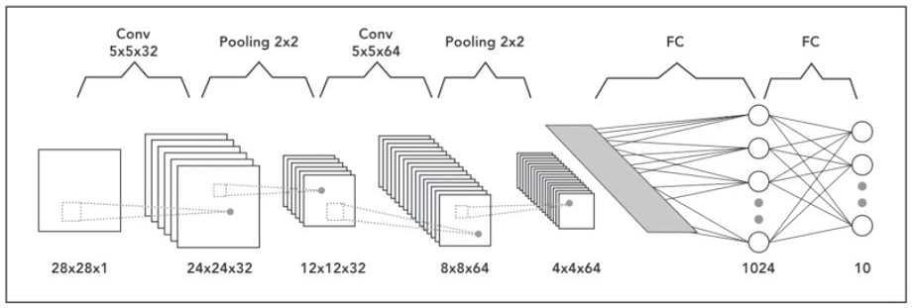
Convolutional Neural Network
Fig 4: Architecture of Convolutional network
https://engmrk.com/convolutional-neural-network-3/

Slide 9
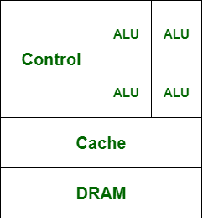
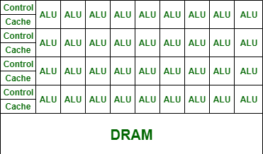
CPU versus GPU
CPU
GPU
Fig 5: Architecture of CPU
Fig 6: Architecture of GPU
Strong individual cores (more versatile ALU)
Less number of cores
Weak individual cores
More number of cores
https://www.geeksforgeeks.org/difference-between-cpu-and-gpu/

Slide 10
Why does having more cores make a difference?
Given an input of size [9,9], if we want to divide it by number 255, say one ALU is capable of completing one division.
Here, a total of 81 computations need to be done
For CPU:
with 4 available ALU, it will take
= 81/4
= 21 total runs.
For GPU:
with 36 available ALU, it will take
= 81/36
= 3 total runs.
* Just for visualization, not actual figures.

Slide 11
CPU vs GPU vs High end GPU
Intel core i5-8250U
Nvidia GeForce GT-1030
Nvidia T4 Tensor core
Cores: 4
Threads: 8
CUDA cores: 384
CUDA cores: 2560
Turing Tensor cores: 320
Base Frequency: 1.60 GHz
MAX Turbo Freq: 3.4 GHz
Base clock frequency: 1228 MHz
Boost: 1468 MHz
Base clock frequency: 585 MHz
Boost: 1590 MHz
RAM: 8GB (MAX 32GB)
MAX Bandwidth: 37.5 Gb/s
RAM: 2GB DDR5
MAX Bandwidth: 48GB/s
RAM: 16GB GDDR6
MAX Bandwidth: 300Gb/s
CUDA compute compatibility: 6.1
CUDA compute compatibility: 7.5
https://ark.intel.com/content/www/us/en/ark/products/124967/intel-core-i5-8250u-processor-6m-cache-up-to-3-40-ghz.html
https://www.nvidia.com/en-us/geforce/graphics-cards/gt-1030/specifications/
https://www.nvidia.com/content/dam/en-zz/Solutions/Data-Center/tesla-t4/t4-tensor-core-product-brief.pdf

Slide 12
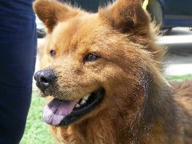
Visualization using a CAT vs DOG Model
Neural Network

Slide 13

DOG
Summary
15 Conv2D layers
6 Max pooling 2D layers
3 Dense layers
Biggest matrix size = [m, 256, 256, 32]

Slide 14
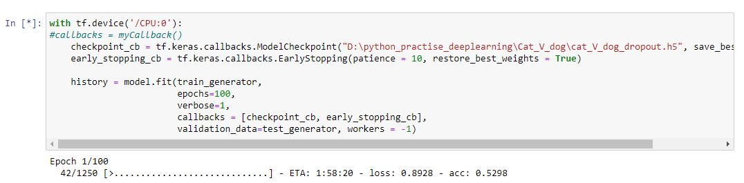
Performance on CPU
Training Conditions:
Pre-Processing step: Normalization, divide each pixel by 255.
Batch size: 16
20,000 training images, 5000 test images
Fig 7: CPU Training snapshot

Slide 15
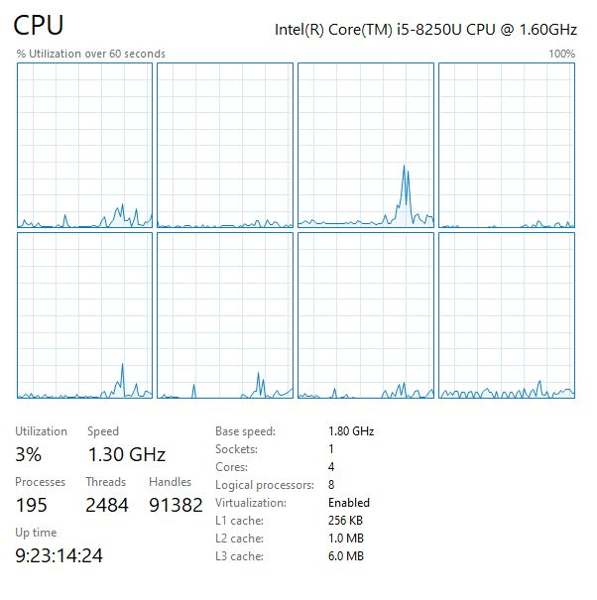
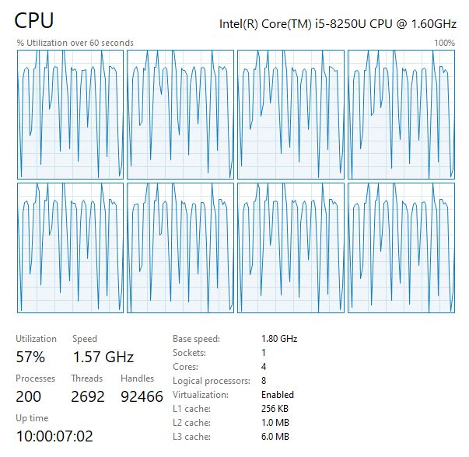
Base CPU utilization
CPU utilization during training
Fig 8: CPU utilization graph (% utilization over 60sec)

Slide 16
Performance on NVIDIA GeForce MX150
Training Conditions:
Pre-Processing step: Normalization, divide each pixel by 255.
Batch size: 16
20,000 training images, 5000 test images
11 min/epoch
Fig 9: GPU MX150 Training snapshot
NOTE: MX150 and GT-1030 are both based on same chipset (GP-108), the latter is desktop version, while MX-150 is modified for laptops.

Slide 17
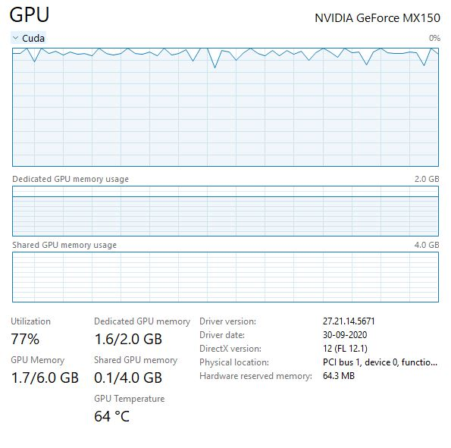
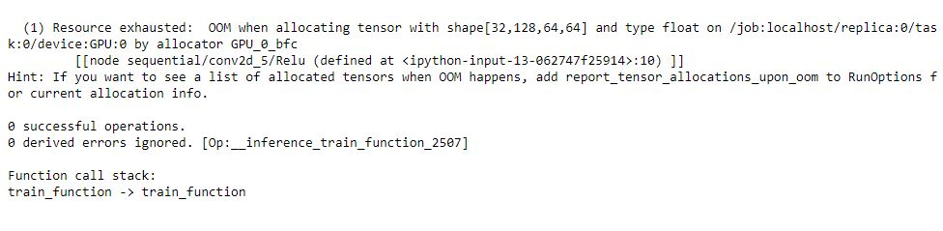
GPU utilization during training
Increasing Batch size to 32
Fig 11: OOM error
OOM error: Out of memory, since tensor of shape [32,128,64,64] could not fit in RAM.
Fig 10: GPU MX150 utilization graph (% utilization over 60sec)

Slide 18
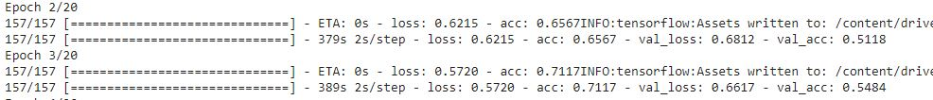
Performance on NVIDIA T4
Training Conditions:
Pre-Processing step: Normalization, divide each pixel by 255.
Batch size: 128
20,000 training images, 5000 test images
Fig 12: GPU T4 Training snapshot
6.3 min/epoch

Slide 19
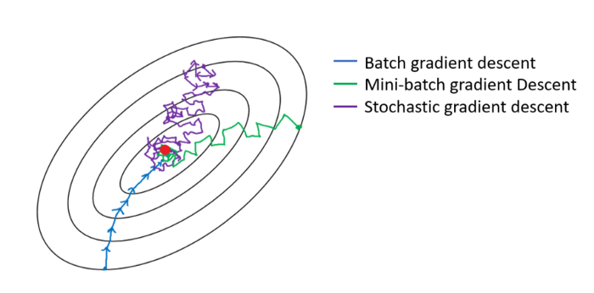
Stochastic VS Batch gradient descent
A large batch size is better.
High speed, large capacity RAM accessible to GPU.
Fig 13: Contour plot for decreasing cost by gradient descent
https://towardsdatascience.com/an-introduction-to-gradient-descent-c9cca5739307

Slide 20
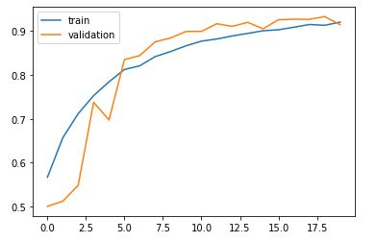
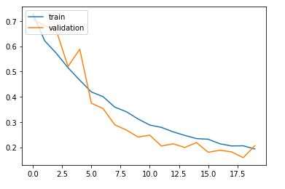
Accuracy
Loss
Accuracy
Loss
Epoch
Epoch
Fig 14(a): Accuracy vs epoch
Fig 14(b): Loss vs epoch

Slide 21
Bibliography
Deep Learning: Ian Goodfellow, Yoshua Bengio and Aaron Courville
Performance on CPU vs GPU for deep learning workloads: Amr Kayid and Yasmeen Khaled: https://www.researchgate.net/publication/224626495_Using_GPUs_for_machine_learning_algorithms
Performance and Scalability of GPU-based Convolutional Neural Networks: Daniel Strigl, Klaus Kofler and Stefan Podlipnig, http://www.dps.uibk.ac.at/~klaus/Klaus_Kofler_-_Institute_for_Computer_Science_files/GPUCNN.pdf
Tensorflow: https://www.tensorflow.org
Original Code: https://github.com/saranshagarwal202/Cats_versus_Dogs

